Slide 1
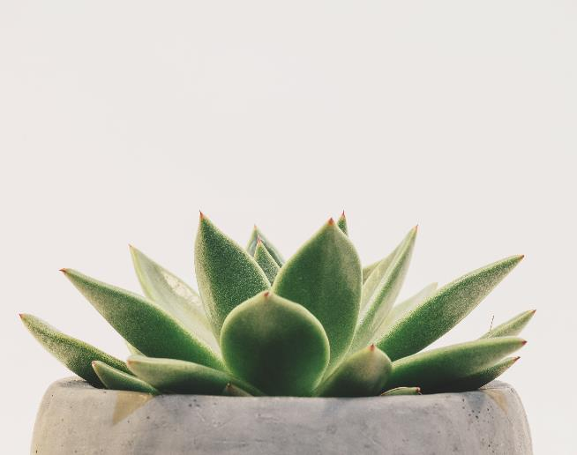
Garden Design

Slide 2

GARDEN ELEMENTS
Seeds
Plants
Weather

Slide 3

PEAK PLANTING SEASON

Slide 4
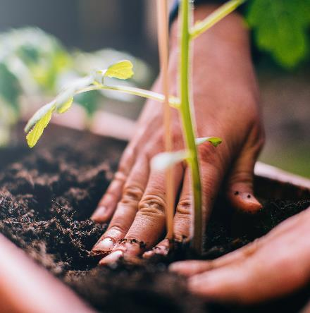
THE PLANTING CYCLE
PLANTING
FEEDING
WATERING
HARVESTING

Slide 5
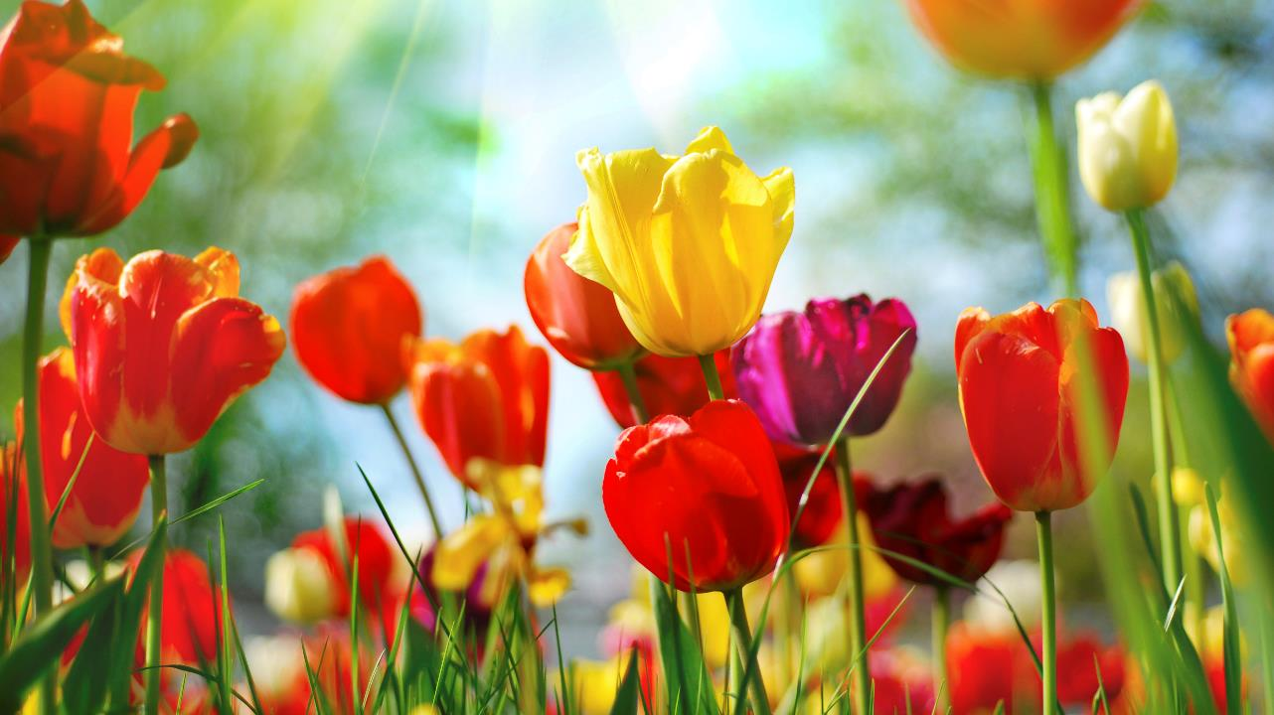
Contact us
someone@example.com

